Slide 1
ME 6224: ENGINEERING MEASUREMENT&INSTRUMENTATION
ME 6207: ENGINEERING MEASUREMENT & CONTROL

Slide 2
MODE OF TEACHING AND LEARNING ACTIVITIES
1.Teaching and learning activities include
Lectures
Tutorials
2.Mode of Assessments include
Continuous Assessment(CA) 40%
Semester Examination(SE) 60%

Slide 3
ASSESSMENT TOOLS
Test One 30%
Assignment 10%
Semester Examination(SE) 60%
Total 100%

Slide 4
COURSE CONTENTS
Fundamentals of Measurements:
Terms, Quantities and Units (Measuring value, Measuring range, Analogue indication, Digital indication); Errors in measurements (accidental and systematic errors).
Measurements:
Temperature Measurements(Definition and methods of measurements);Resistance thermometer, Bi-metallic thermometer(function and application), Force and Pressure Measurements, Measurement of Speed, Liquid Level and Quantity Measurements (floating ball, U-tube, load cells, flow meter)

Slide 5
COURSE CONTENTS….
Fundamentals of Control Systems: Open and closed loops; Application; Signal flow, Schematic and Block diagrams, Discontinuous controllers (Two step controller, three step controller); Continuous controllers (P-controllers, I-controllers and PI-controllers).
Electrical and Electronic Components: Identify and explain electrical components with contacts (relay, switches, regulators, etc); Identify and explain electronic contactless components (diodes, transistors, etc).

Slide 6
COURSE CONTENTS….
Pneumatics: Physical fundamentals (physical quantities, properties), Pneumatic components and symbols.
Hydraulics: Physical fundamentals (properties, physical quantities and units of hydraulics); hydraulic components and symbols;
Logic Junctions Elements: Logic operations (junction elements, truth tables); Fundamentals of switching algebra (logic circuits, Boolean algebra, Boolean equations); Stores (pulse stores, time elements, etc).

Slide 7
Learning objectives
At the end of this lecture participants should be able to;
Define the term measurement
Describe the basic SI units of measurement
Explain methods of measurement
Describe the elements of measurement
Explain the application of measurement systems
Describe factors affecting measurement

Slide 8
INTROUCTION TO MEASUREMENT

Slide 9
INTRODUCTION
Measurement techniques have been of immense important ever since the start of human civilization, when measurement were first needed for transfer of goods in batter trade in order to ensure for a fair exchange.
The industrial revolution during 19th century brought about a rapid development of new instruments and measurement techniques to satisfy the needs for industrialized production techniques.

Slide 10
Introduction…
Since that time, there has been a large and rapid growth in new industrial technology. In turn, this has required a parallel growth in instrument and measurement techniques.

Slide 11
THE CONCEPT OF MEASUREMENT
Measurement can be defined in various ways. It may be referred to as a process of gathering information from the physical world and compare it with the agreed standards.
In other words it is the process of comparing physical quantities with the known standards or a process of assigning digits to some parameters.

Slide 12
Concept….
Measurement is carried out with instruments that are designed and manufactured to fulfill the given specifications.
In the application of measurement, the information about a physical variable is collected, organized and interpreted.
The process of using instrument designed to comprehend a certain information during measurement is known as instrumentation.

Slide 13
concept…..
A measurement instrument is a device capable of detecting changes, display physical or otherwise, in a particular process.
It then converts these physical changes into some form of information understandable by the user

Slide 14
concept….
Human senses can be very keen but are lacking in some circumstances.
Our ability to sense for instance hot or cold is only relative and can be limited over a certain temperature ranges.
However measurement of very high electric voltage with human senses can be hazardous; thus the use of instruments in measurements become vital.

Slide 15
Why measurement?
People makes measurement for several reasons, some of which are;
  To ensure that an item will fit.eg. Bolt and nut
  To check that the manufactured item is within
  specification
  To determine the correct price to pay for
  something etc.

Slide 16
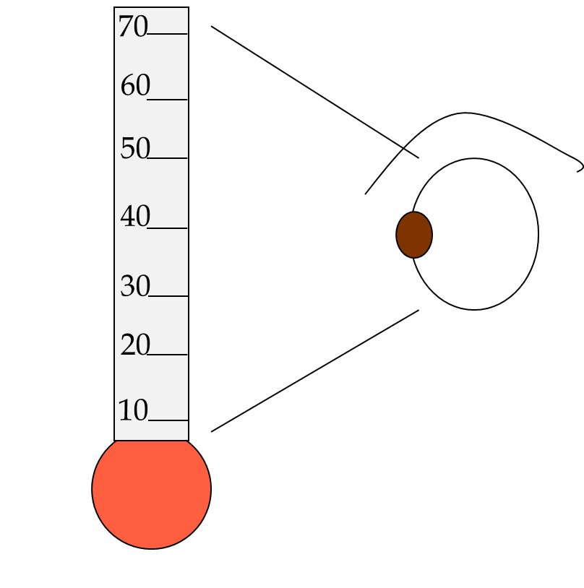
Forms of measuring instrument
(i) Indication
This is the simplest form of measurement; it allows us to know the current state of the variable.

Slide 17
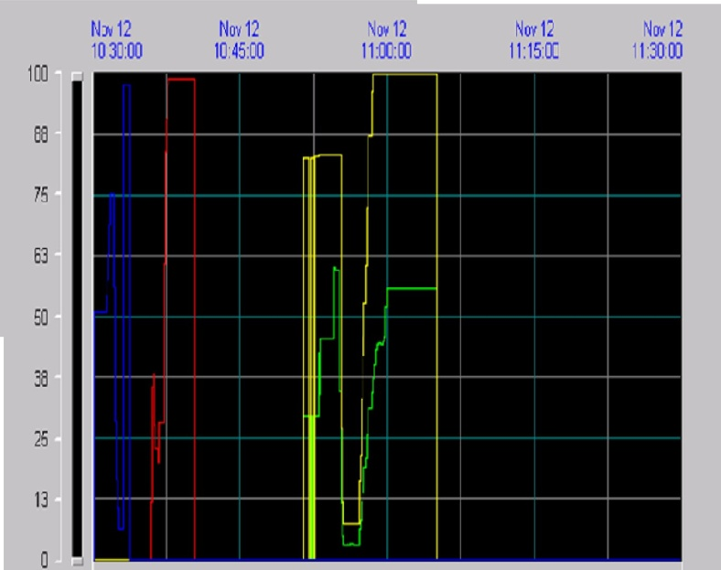
Forms of measuring instrument
(ii) Recorder
A device that can store data allows us to observe the current state of the variable and how it behaved in the past. A recorder provides us with the history of the variable.

Slide 18
THE INTERNATIONAL SYSTEM OF SI-UNITS
The International system of units has the abbreviation SI and it is considered to be a centre of all modern science and technology worldwide which ensure that measurement can be put in standards.
This keeps measurement made in various countries to be compatible to one another.

Slide 19
FUNDAMENTAL BASIC SI UNITS
There are seven basic SI units in which all physical quantities can be expressed; these are:
Quantity | SI Units | Symbol
Length | meter | m
Mass | kilogram | kg
Time | second | S
Electrical current | ampere | A
Temperature | Kelvin/degree | K/C
Luminous Intensity | candela | cd
Amount of substance | mole | mol

Slide 20
Derived SI units
All measurement can be expressed using combination of seven basic units is known as the derived units.
Quantity | Unit | symbol
Area | Square meter | m²
2. Volume | Cubic meter | m³
3. Speed | Meter per second | m/s
4. Acceleration | Meter per second per second | m/s²
5. Force | Newton | N
6. Energy | Joule | J
7. Power | watt | W

Slide 21
Prefixes for multiple units
A shorthand system of prefixes was agreed as part of the SI unit. All prefixes are related to each other by power of 10 making it very easy to use.
There are a number of prefixes agreed to be used in engineering, hereunder are some common prefixes in use.

Slide 22
Prefixes for multiple units cont….
Prefix | Symbol | decimal | Power of 10
1. tera | T | 1 000 000 000 000 | 10 ¹²
2. giga | G | 1 000 000 000 | 10⁹
3. Mega | M | 1 000 000 | 10⁶
4. Kilo | k | 1 000 | 10³
5. Hecto | h | 1 00 | 10²
6. Deca | da | 10 | 10
7. Deci | D | 0.1 | 10⁻¹
8. Centi | C | 0.01 | 10⁻²
9. Milli | M | 0.001 | 10⁻³
10. Micro | µ | 0.000001 | 10⁻⁶
11. Nano | N | 0.000000001 | 10⁻⁹
12. pico | P | 0.000000000001 | 10⁻¹²

Slide 23
Important terms in measurement
ACCURACY: Accuracy is about how close measurements are to the ‘true value. A qualitative term that describes how close a set of measurements are to the actual (true) value.
PRECISION: Describes the spread of these measurements when repeated - a measurement that has high precision has good repeatability.

Slide 24
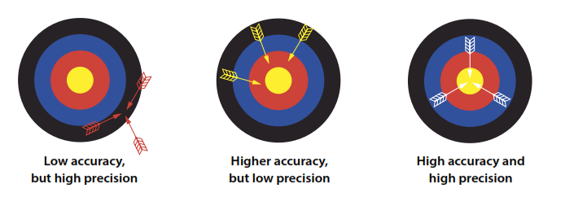
Measurement characteristics

Slide 25
Important terms cont……
ERROR: is the difference between the measured value and the true value of the quantity being measured.
TRUE VALUE: is the value that would be obtained by a theoretically perfect measurement
TOLERANCE: This is the maximum agreed allowable variation between the actual value of quantity and the value specified for it
UNCERTAINITY: this is the quantification of the doubt existing about the measurement results that tells something about its quality

Slide 26
THE UNCERTAINTY OF MEASUREMENTS
Some numerical statements are exact; for example:
(i) Mary has 3 brothers, and
(ii) 2 + 2 = 4.
However, all measurements have some degree of uncertainty that may come from a variety of sources.
The process of evaluating the uncertainty associated with a measurement result is often called uncertainty analysis or error analysis.

Slide 27
Uncertainty …
The complete statement of a measured value should include an estimate of the level of confidence associated with the value.
Without an uncertainty estimate, it is impossible to answer the basic scientific question: "Does my result agree with a theoretical prediction or results from other experiments?"
This question is fundamental for deciding if a scientific hypothesis is confirmed or refuted.

Slide 28
When we make a measurement, we generally assume that some exact or true value exists based on how we define what is being measured

Slide 29
Errors in measurement of Physical Quantities
Any measurement made with a measuring device is approximate. If you measure the same object two different times, the two measurements may not be exactly the same. The difference between two measurements is called an error.
The error in measurement is a mathematical way to show the uncertainty in the measurement. It is the difference between the result of the measurement and the true value.

Slide 30
Types of errors
Instrumental (or constant) Error: These errors are caused due to fault construction of instruments. Such errors can be minimized by taking same measurement with different accurate instruments.
Systematic (Persistent) Error: This is an error due to defective setting of an instrument. Such error can be minimized by detecting its causes.

Slide 31
Types of error ….
Personal Error: These errors introduced due to fault of an observer taking readings, referred to human error.
Random (Accidental) Error: Even after minimizing above types of errors, error may occur due to different factors like pressure, temperature fluctuation in voltage while the experiment is being performed.
Such errors cannot be eliminated but can be minimized

Slide 32
Error Analysis
Error in measurement is the amount of inaccuracy. It tells more about the different that exist between the true value (theoretical) and the measured result.
The error occurs as a result of uncertainties. In other words it is a result of some assumed factors that may be not easy to control.
Therefore, for the error not to affect measurement, it must be within agreed standard.

Slide 33
Error Analysis……..
Unfortunately, the terms error and uncertainty are often used interchangeably to describe both imprecision and inaccuracy. This usage is so common that it is impossible to avoid entirely.
Whenever you encounter these terms, make sure you understand whether they refer to accuracy or precision, or both.

Slide 34
Error Analysis……
Notice that in order to determine the accuracy of a particular measurement, we have to know the ideal, true value.

Slide 35
Error Analysis…….
Precision is often reported quantitatively by using relative or fractional uncertainty
Relative Uncertainty = uncertainty
measured quantity
For example: If the measured value is 75.5g with possible error ± 0.5g the relative uncertainty = 0.5/75.5
= 0.06%

Slide 36
Relative error
Accuracy is often reported quantitatively by using relative error
Relative Error = measured value-expected value
expected value

Slide 37
Relative error…..
If the expected value for m is 80.0 g, then the relative error is
(75.5- 80.0)/80.0 = -0.056 = -56%
Note: The minus sign indicates that the measured value is less than the expected value.

Slide 38
Relative error……
When analyzing experimental data, it is important that you understand the difference between precision and accuracy
Precision indicates the quality of the measurement, without any guarantee that the measurement is "correct." while…

Slide 39
Relative error…..
Accuracy, on the other hand, assumes that there is an ideal value, and tells how far your answer is from that ideal, "right" answer.
These concepts are directly related to random and systematic measurement errors.

Slide 40
Elements of measurement system
A measuring system exists to provide information about the physical value of some variables being measured.
In simple cases, the system can consist of only a single unit that gives an output reading or signal according to the magnitude of the unknown variable applied to it.

Slide 41
Element of measurement system …..
However, in more complex measurement situations, a measuring system consists of several separate elements to comprehend measurement may be applied.
The term measuring instrument is used commonly to describe a measurement system, whether it contains only one or many elements

Slide 42
Elements of measurement system….
The first element in any measuring system is the primary sensor: this gives an output that
is a function of the measurand (the input applied to it).
For most but not all sensors, this function is at least approximately linear. Some examples of primary sensors are a liquid-in-glass thermometer, a thermocouple, and a strain gauge.

Slide 43
Elements of measurement system….
In the case of a mercury-in-glass thermometer, because the output reading is given in terms of the level of the mercury, this particular primary sensor is also a complete measurement system in itself.

Slide 44
Elements of measurement system….
Variable conversion elements are needed where the output variable of a primary transducer is in an inconvenient form and has to be converted to a more convenient form.
For instance, the displacement-measuring strain gauge has an output in the form of a varying resistance.

Slide 45
Elements of measurement system….
Because the resistance change cannot be measured easily, it is converted to a change in voltage by a bridge circuit, which is a typical example of a variable conversion element

Slide 46
Elements of measurement system….
In some cases, primary sensor and variable conversion element are combined; this combination is known as a transducer.
Signal processing elements exist to improve the quality of the output of a measurement
system in some way.

Slide 47
Elements of measurement system….
A very common type of signal processing element is the electronic amplifier, which amplifies the output of the primary transducer or variable conversion element, thus improving the sensitivity and resolution of measurement.

Slide 48
Methods of measurements
Direct method:
Unknown quantity (measurand) is directly compared against a standard. Commonly for measurement of physical quantities like length, mass and time.
Indirect methods:
The input has to be processed to some processing device and the output signal is fed to the system for interpretation, e.g. measuring vehicle fuel tank level basing on variable resistance from the sender unit.

Slide 49
The choice of appropriate measuring instrument
The choice of measuring instrument depends on the following:
  Accuracy of measurement desired
  Resolution of the measuring instrument
  Sensitivity of the instrument Dynamic performance of instrument and
  Environmental condition

Slide 50
Application of measurement systems
Monitoring of process and operation
Controlling of process and operation
3. Analyzing of experiment

Slide 51
1.Monitoring of process and operation
These are certain applications of measuring instruments that have essentially a monitoring function. They simply indicate the value or condition of parameter under study and their readings do not serve any control functions.
For example, an ammeter or a voltmeter indicates the value of current or voltage being monitored (measured) at a particular instant.

Slide 52
Monitoring of process and operation..
Similarly, water and electric energy meters installed in homes keep track of commodity used so that later on its cost may be computed to be realized from the user.
Another example includes a temperature thermometer that used to track the reading of a hot body for controlling purposes

Slide 53
2. Controlling of process and operation
A very useful application of instruments is in automatic control systems. There has been a very strong association between measurement and control.
In order that process variable like temperature, pressure, humidity, etc. may be controlled, the prerequisite is that can be measured at the desired location in the individual parts.

Slide 54
3. Analyzing of experiment
For solution of engineering problems, theoretical and experimental methods are available.
Many applications require application of both the methods. The relative affectability of the method depends upon the nature of the problem. Experimental engineering analysis has many uses and some are listed below:

Slide 55
Uses of engineering experimental analysis
Testing and validity of theoretical predictions.
Formulations of generalized empirical relationships in cases where no proper theoretical backing exists.
Determination of system parameters, valuable and performance indices.
For development in important spheres of study where there is ample scope of study.
Solutions of mathematical relationships with the help of analogies

Slide 56
Factors affect measurement.
Many factors can reduce accuracy or precision and increase the uncertainty of your measurement result. Some of the most common are:
• Environmental conditions – changes in temperature or humidity can expand and contract materials as well as affect the performance of measuring equipment.
• Inferior measuring equipment – equipment which is poorly maintained, damaged or not calibrated will give less reliable results.

Slide 57
Factors affect measurement….
• Poor measuring techniques – having consistent procedures for your
measurements is vital, incompetence measuring skills results to error.
• Inadequate ability and skills– not knowing how to make the right measurement will have negative impact to the results.

Slide 58
END OF PRESENTATION

